Slide 1

My Algebra Interactive Notebook
Name
Class
Teacher
Semester 2
Term 3
1

Slide 2

Interactive Notebooks!
Cover Page
Contents Page
Glossary
24/7/30
EQ
Questions
Notes
Summaries
Work page
Presentation!!!
Your book, your responsibility!

Slide 3
From last class…
What Operation Do You Do?
FIRST SECOND
1) 3x + 8 = 24
Divide by 3
Subtract 8
2) 5x - 10 = 19
Add 10
Divide by 5
Alright, so you know what to do. Now solve them on the LHS of your INB!!!

Slide 4
Balancing Equations Video
https://www.youtube.com/watch?v=DO-hzLh79uw

Slide 5
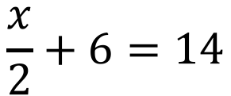
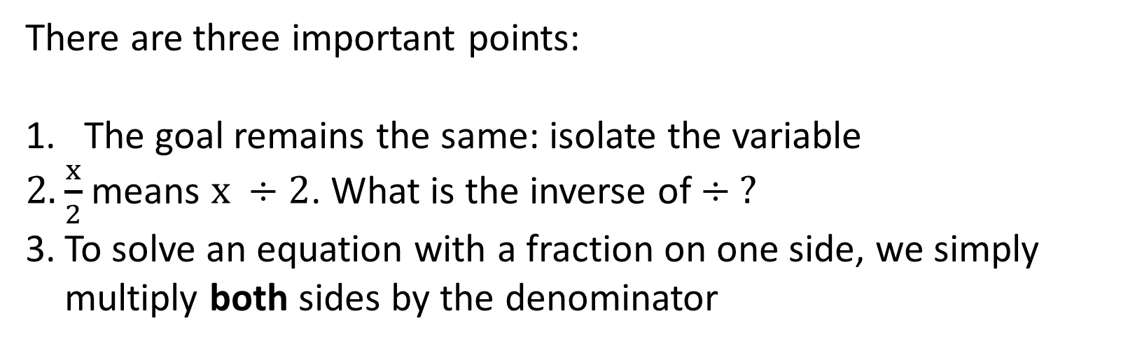
24
7
30
Solving Multi-Step Algebraic Equations
Date
EQ – How do we solve more advanced multi-step equations?
What happens when there are fractions?
Consider the following:
$$\frac{x}{2}+6=14$$
There are three important points:
The goal remains the same: isolate the variable
$\frac{x}{2}$ means $x ÷2$. What is the inverse of $÷ ?$
To solve an equation with a fraction on one side, we simply multiply both sides by the denominator
Let’s see how that looks when we solve it
Summary:

Slide 6
24
7
30
Solving Multi-Step Algebraic Equations
Date
EQ – How do we solve more advanced multi-step equations?
x 2
Get the variable alone.
+ 6 = 14
What happens when there are fractions?
Subtract 6 from both sides.
- 6 - 6
+ 6 and -6 cancel out.
x 2
= 8
Multiply both sides by the denominator, 2
x 2
2
( ) = 8
2
2 divided by 2 cancels out
x = 16
16
2
Show your check.
+ 6 = 14
8 + 6 = 14
Finish your check.
14 = 14

Slide 7
24
7
30
Solving Multi-Step Algebraic Equations
Date
EQ – How do we solve more advanced multi-step equations?
x 3
One more example with fractions
– 4 = 8
Get the variable alone.
+4 +4
Add 4 to both sides.
x 3
+ 4 and -4 cancel out.
= 12
x 3
Multiply both sides by the denominator, 3.
3 ( ) = 3 12
x = 36
3 divided by 3 cancel to 1
36
3
Show your check.
– 4 = 8
12 – 4 = 8
Finish your check.
8 = 8

Slide 8
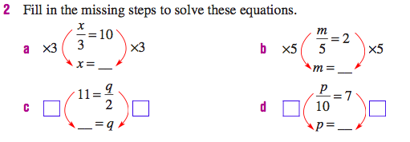
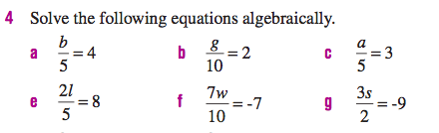
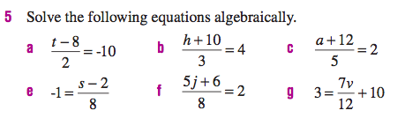
Your turn

Slide 9
24
7
30
Solving Multi-Step Algebraic Equations
Date
EQ – How do we solve more advanced multi-step equations?
REVIEW: Simplify Using the Distributive Property.
What happens when there are brackets?
Distributive Property – Multiply everything in the parentheses.
a ( b + c ) =
ab + ac
ab – ac
OR a ( b – c ) =
Example 1: -3 ( x + 5 )
= -3x - 15
Example 2: -7 ( 2a – 4 )
= -14a + 28

Slide 10
24
7
30
Solving Multi-Step Algebraic Equations
Date
EQ – How do we solve more advanced multi-step equations?
REVIEW: Simplify Using Combining Like Terms
What happens when there are brackets?
Like Terms must have the same variables and the same powers on the letters.
Combine like terms by adding or subtracting the coefficients (numbers in front of the variables).
Example 1: 3x + 5 – 7x + 9
-4x
+ 14
Example 2: 3 – 6y – 7 – 9y
-4
– 15y

Slide 11
24
7
30
Solving Multi-Step Algebraic Equations
Date
EQ – How do we solve more advanced multi-step equations?
FIRST - Use the Distributive Property to get rid of the parentheses.
Example: 3 ( x – 2 ) + 4x = 8
SECOND: Combine like terms.
– 6
+ 4x = 8
3x
Copy the rest of the problem.
– 6 = 8
7x
+ 6 + 6
Add 6 to both sides.
Now it’s a regular 2-step equation.
7x = 14
Divide both sides by 7.
7 7
x = 2

Slide 12
24
7
30
Solving Multi-Step Algebraic Equations
Date
EQ – How do we solve more advanced multi-step equations?
Example 2
Example: 3x + 2 ( 2x – 1 ) = 33
Use Distributive Property
2. Combine Like terms
3. Use Inverse Operations
4x
– 2
3x + = 33
7x
– 2 = 33
+ 2 + 2
7x = 35
7 7
x = 5

Slide 13


Your turn

Slide 14
24
7
30
Solving Multi-Step Algebraic Equations
Date
EQ – How do multi-step equations differ from one and two-step equations?
Solving Multi-Step
Equations
Don’t forget!!!
Summary:

Slide 15
Notes Review
24, 7 ,30
Date
Title
Essential question
Notes complete
Notes complete with colour and diagrams
Questions completed
Contents page filed in
Formula page filled in

